Slide 1
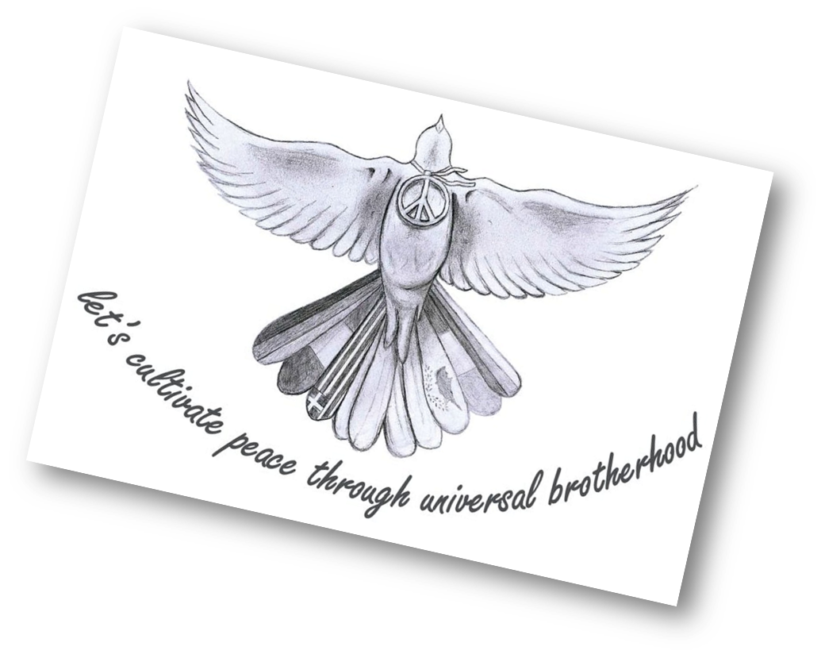
Zhenya Marcheva
Erasmus +
Silistra, Bulgaria
Language High School ‘Peyo Yavorov’
Xa grade

Slide 2
2018 Kabul ambulance bombing
Made by Zhenya Marcheva

Slide 3
On 27 January 2018, an ambulance was used as a vehicle-borne improvised explosive device near the Sidarat Square in Kabul, Afghanistan.

Slide 4
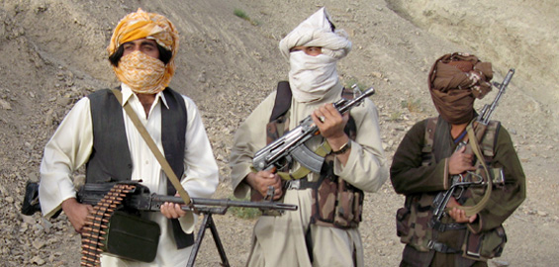
At least 103 people were killed and 235 others wounded in the attack. The Taliban claimed responsibility for the attack.
The Taliban

Slide 5
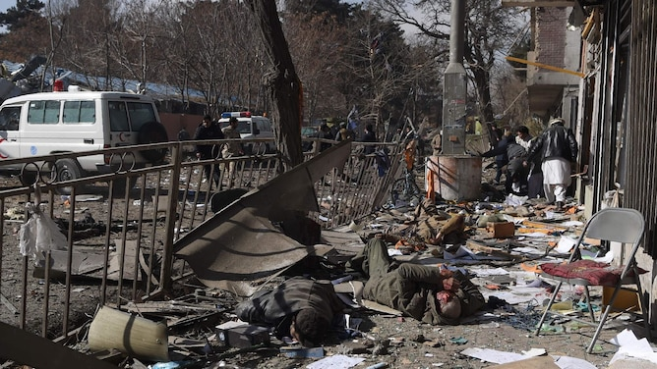
The bombers detonated the explosives while passing through the second in a series of checkpoints near Kabul's embassies and government buildings including the European Union consulates.
The explosion was so powerful that the shock was felt around the capital, collapsing buildings and destroying facades in the immediate area.

Slide 6
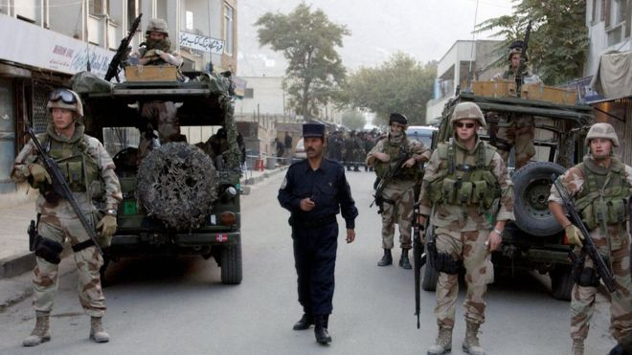
According to reports, the vehicle was stopped at a second security checkpoint after passing the primary one claiming they had a patient. When police attempted to stop the vehicle from going further, the driver detonated the bomb.
The attack occurred on a street, locally known as Chicken Street

Slide 7
Remember – war is NEVER the answer!
Thank you for your attention!

