Slide 1
Charlie Hebdo - Shooting
Erasmus +
Niya Andreeva
Silistra, Bulgaria
Language High School ‘Peyo Yavorov’
Xa class

Slide 2
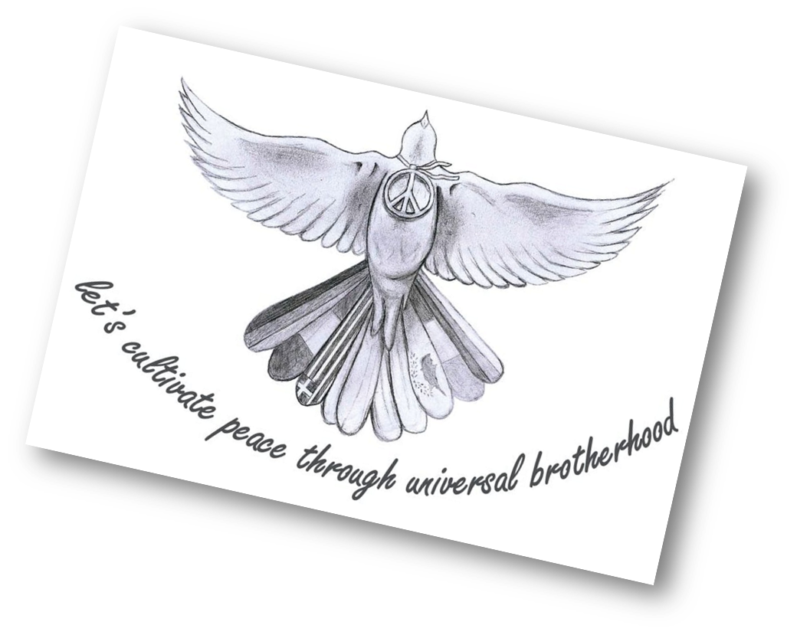

Slide 3
7th January 2015
At about 11:30 a.m. local time.
Two brothers, Saïd and Chérif Kouachi, forced their way into the offices of the French satirical weekly newspaper Charlie Hebdo in Paris.

Slide 4
Victims
killed 12 people
injured 11 others

Slide 5
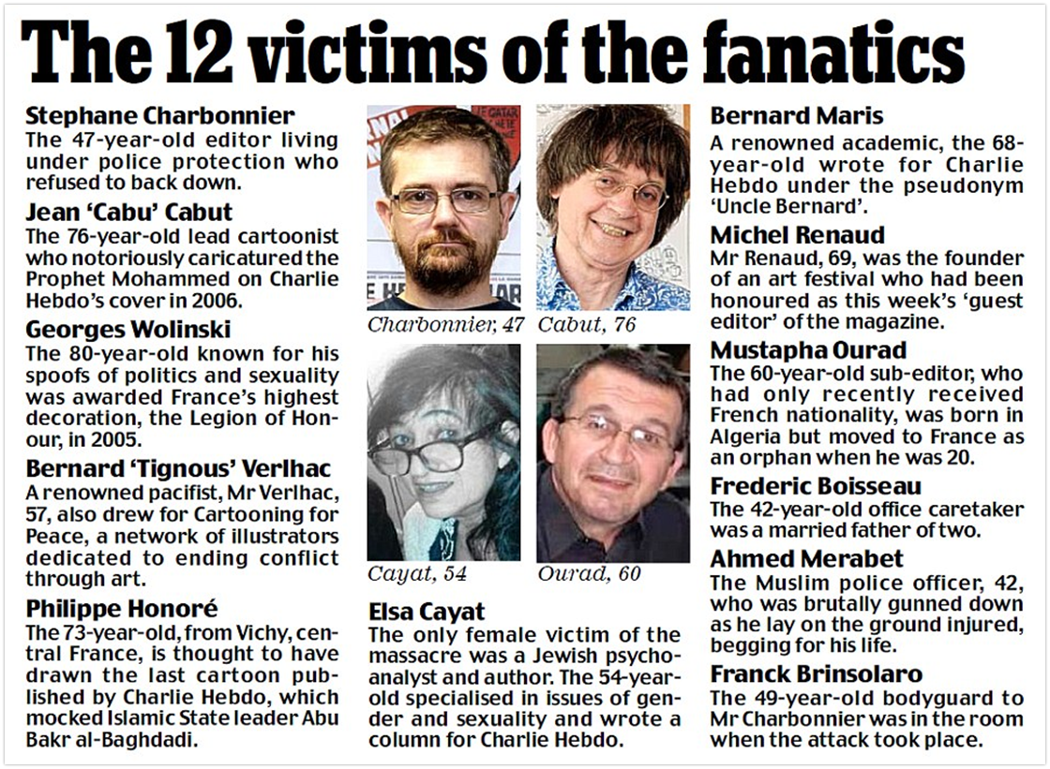

Slide 6
Who took responsibility for the attack?
The Islamist terrorist group Al-Qaeda's branch in Yemen.

Slide 7
What happen after that?
On the 11th of January, about two million people, including more than 40 world leaders, met in Paris for a rally of national unity, and 3.7 million people joined demonstrations across France.

Slide 8
What happen after the shooting?
The phrase ‘Je suis Charlie’ became a common slogan of support at the rallies and in social media.

Slide 9
The staff of Charlie Hebdo
Continued with the publication, and the following issue print ran 7.95 million copies in six languages, compared to its typical print run of 60,000 in only French.

Slide 10
Thank you for your attention!

