Slide 1
Betty williams
Eirini

Slide 2
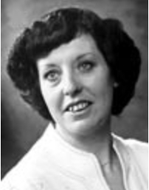
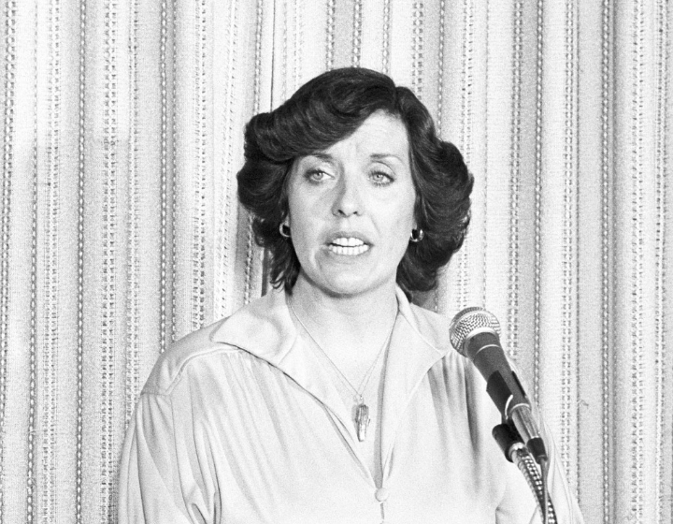
Betty williams Biography
Betty Williams (born 22 May 1943, Belfast, Northern Ireland) is a co-recipient with Mairead Corrigan of the Nobel Peace Prize in 1976 for her work as a cofounder of Community of Peace People, an organization dedicated to promoting a peaceful resolution to the Troubles in Northern Ireland.

Slide 3
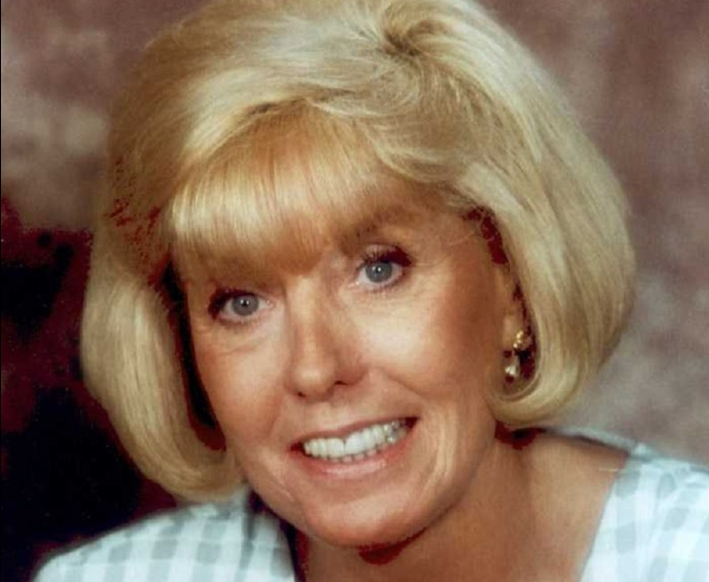
Declaration of the Peace People
We have a simple message to the world from this movement for Peace.
We want to live and love and build a just and peaceful society.
We want for our children, as we want for ourselves, our lives at home, at work, and at play to be lives of joy and Peace.
We recognise that to build such a society demands dedication, hard work, and courage.
We recognise that there are many problems in our society which are a source of conflict and violence.
We recognise that every bullet fired and every exploding bomb make that work more difficult.
We reject the use of the bomb and the bullet and all the techniques of violence.
We dedicate ourselves to working with our neighbours, near and far, day in and day out, to build that peaceful society in which the tragedies we have known are a bad memory and a continuing warning.

Slide 4
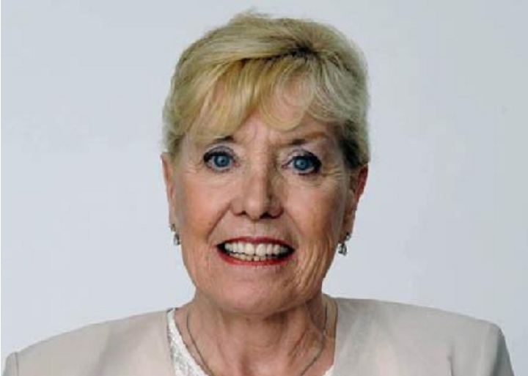
BETTY’S Nobel Peace Prize
In recognition of her efforts for peace, Williams, together with her friend Mairead Corrigan, became joint recipients of the Nobel Peace Prize in 1977 (the prize for 1976).

Slide 5
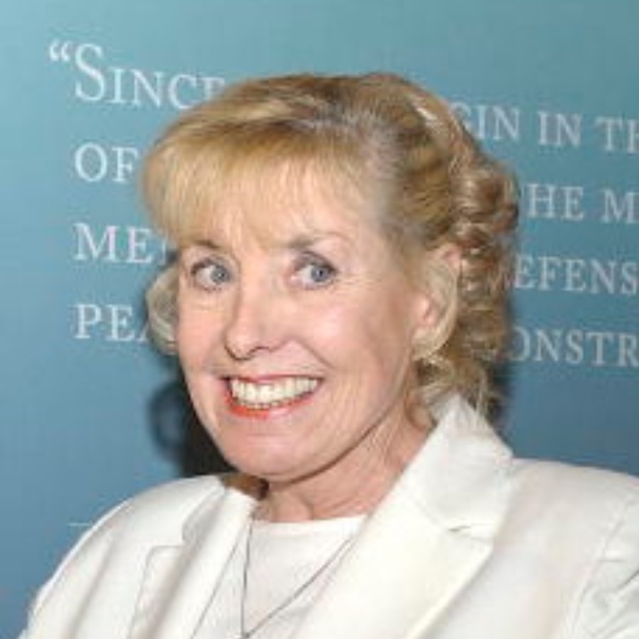
Other awards
Since winning the Nobel Peace Prize, Williams has received the People's Peace Prize of Norway in 1976, the Schweitzer Medallion for Courage, the Martin Luther King, Jr. Award, the Eleanor Roosevelt Award in 1984, and the Frank Foundation Child Care International Oliver Award. In 1995 she was awarded the Rotary Club International "Paul Harris Fellowship: and the Together for Peace Building Award. ^{[8]}

Slide 6
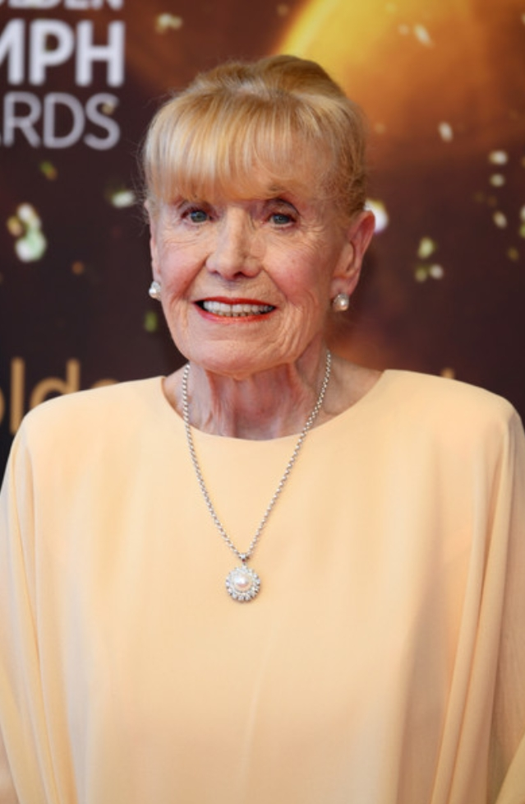
Personal life
At the time she received the Nobel Prize, Williams worked as a receptionist and was raising her two children with her first husband Ralph Williams. After they divorced, she married James Perkins in 1982, and resided in Ponte Vedra Beach, Florida in the United States. She toured and lectured extensively, taking the Nobel Peace Prize with her, so others could see and be inspired by it.
Her son Paul became a professional footballer playing for Newport County, Sheffield United, Hartlepool United, Stockport County, West Bromwich Albion and Rochdale. He made one appearance for Northern Ireland.
In 1992, she was appointed to the Texas Commission for Children and Youth by then Texas Governor, Ann Richards.
She spent time as a visiting professor at Sam Houston State University, in Huntsville, Texas. In 2004, she returned to live in Ireland where she currently resides.

Slide 7
Information by:
https://en.m.wikipedia.org/wiki/Betty_Williams_(Nobel_laureate)

