Slide 1
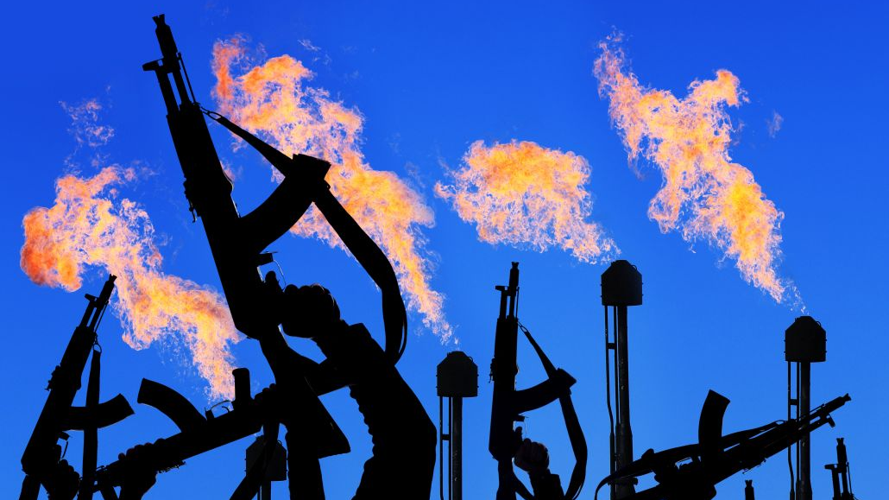
2012 BURGAS BUS BOMBING
Made by
Burchin Belgin Nezhdet
X grade
Silistra,Bulgaria
Erasmus +

Slide 2
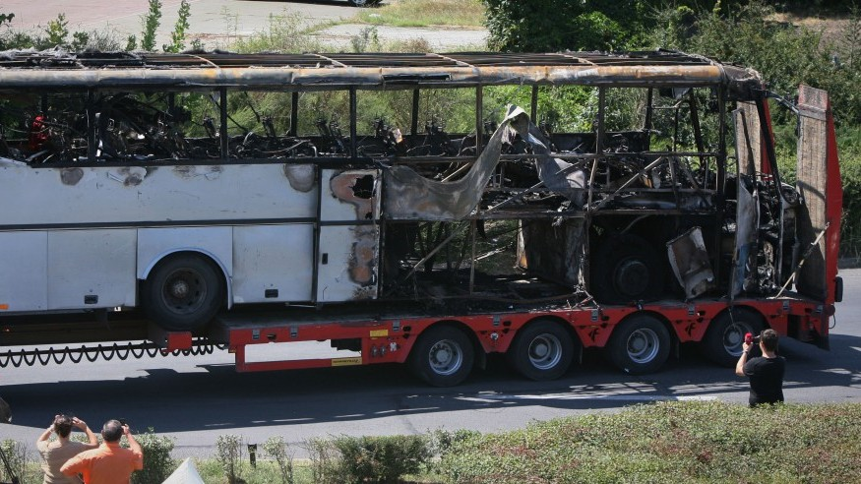
Attack
Seven people (including the suicide bomber) were killed and at least thirty-two injured in an explosion on an Israeli-operated tour bus at the Burgas Airport in the Black Sea city of Burgas, with a population of some 200,000 people.

Slide 3
Perpetrator investigations
Following the attack, a probe was launched to determine who was responsible for the attack. On 12 August, a probe into the attack concluded that the perpetrator was a suicide bomber, which disproved other possible theories, such as being a deluded drug smuggler. On 17 August, Tsvetan Tsvetanov said that the probe indicated that a country or terrorist organization was responsible for the bus bombing, but did not name any suspects.
Sketch released by Bulgarian authorities of a man who is believed to be either an accomplice or the bomber

Slide 4
Accomplices
On 16 August, the Bulgarian authorities released a computer-generated image of a suspected accomplice, saying that "There is data that the man is related to the terrorist attack at the airport." The authorities thought it belonged to the suicide bomber, but a facial reconstruction determined that this was not the case, and raised the possibility of an accomplice.

Slide 5
Reactions
Across the globe, foreign governments offered support and solidarity to the citizens and authorities of Bulgaria and Israel, and expressed their condolences for the victims. United Nations Secretary-General Ban Ki-moon condemned the attack in "the strongest possible terms" and expressed his condolences, and the United Nations Security Council unanimously condemned the attack in Burgas as a terrorist attack and expressed its condolences as well.

Slide 6
Bulgarian ceremony
In late August 2012, Bulgaria held a remembrance ceremony in honor of the victims of the terrorist attack. Two ceremonies were held, one in Sofia's largest synagogue, which prepared a curation of the ark that contained the names of the victims, and another ceremony was held in Burgas. Israeli groups were accompanied by guards and police canine units, and security was tight.

Slide 7
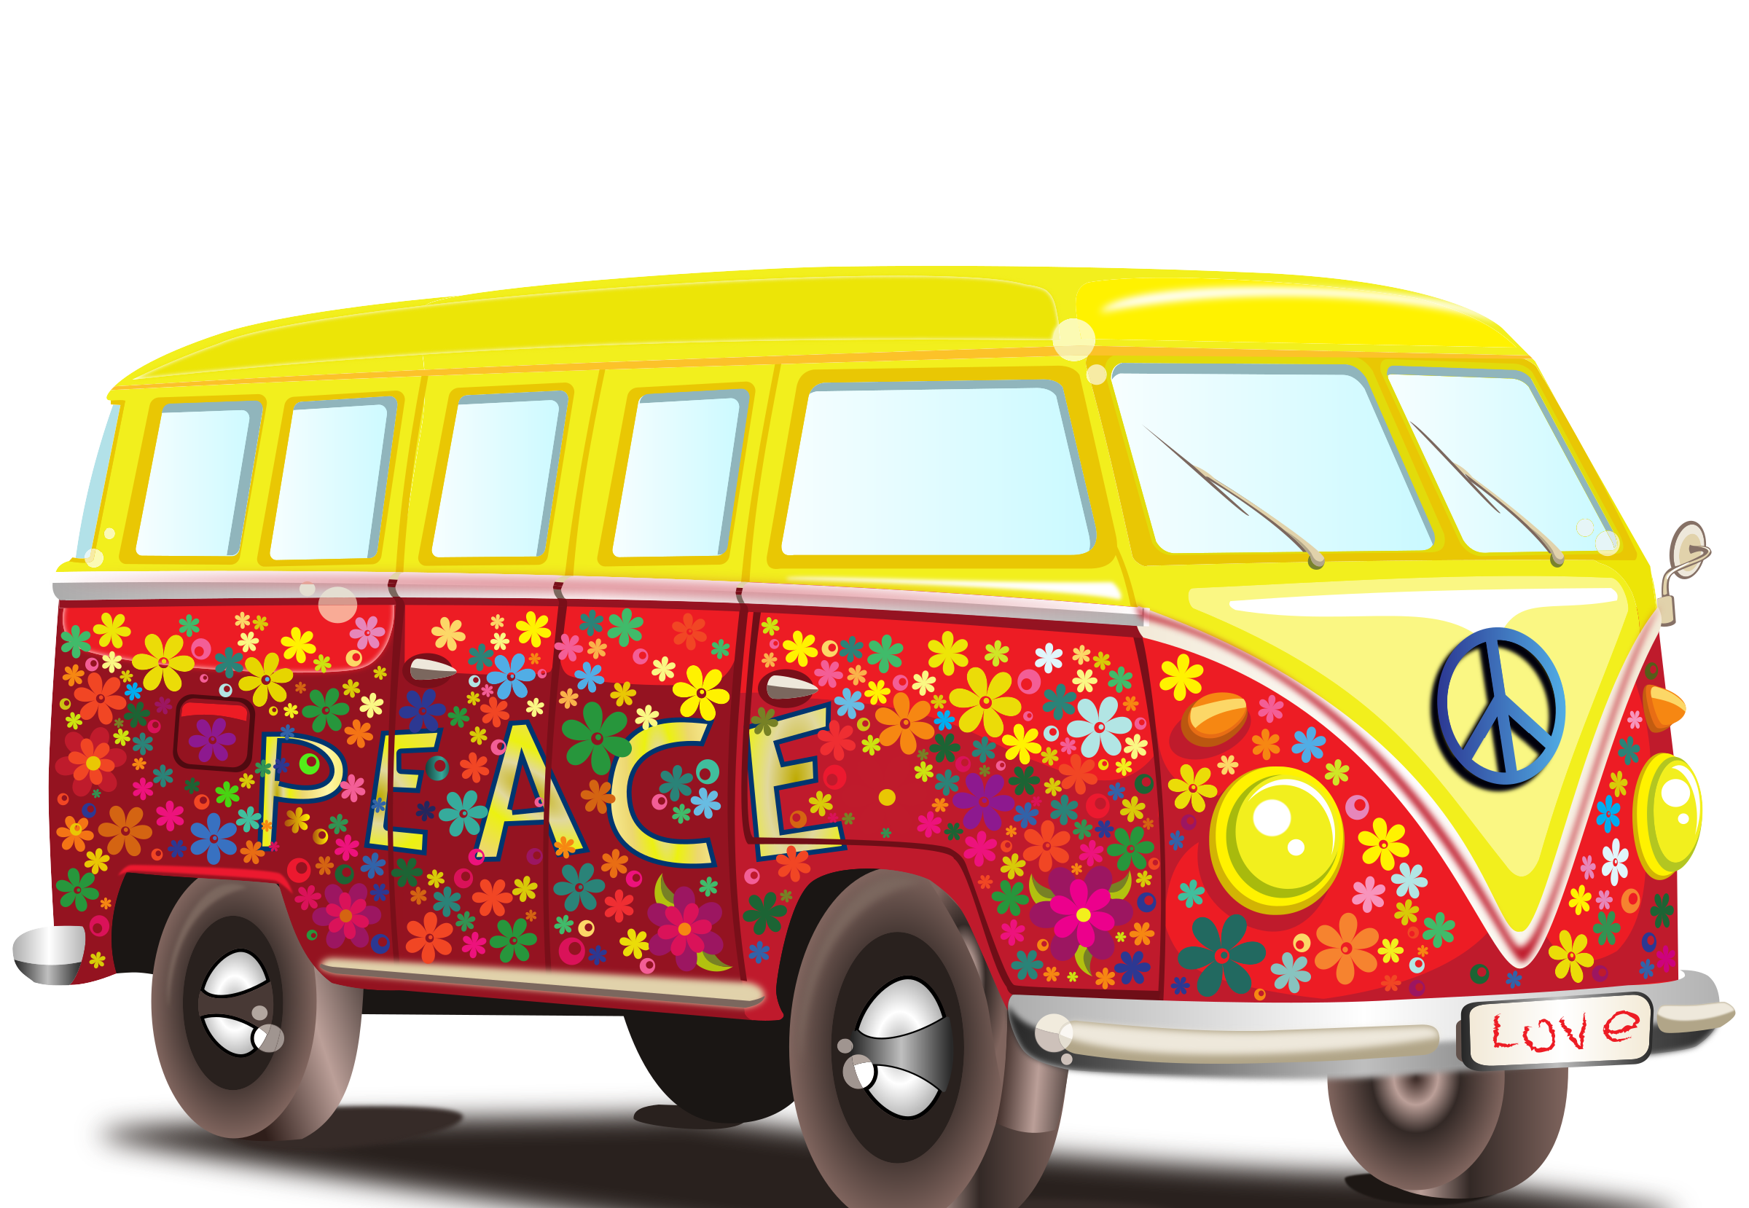
Make peace instead of war!

Slide 8
