Slide 1
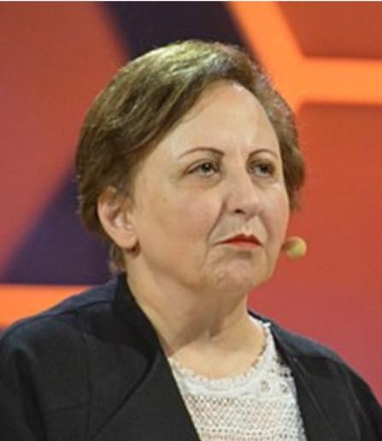
Shirin Ebadi

Slide 2
Shirin Ebadi(Born 21 June 1947) is an Iranian lawyer, a former judge and human rights activist and founder of Defenders of Human Rights Center in Iran. On 10 October 2003, Ebadi was awarded the Nobel Peace Prize for her significant and pioneering efforts for democracy and human rights, especially women's, children's, and refugee rights. She was the first Iranian and the first Muslim woman to receive the prize, and thousands greeted her at the airport when she returned from Paris after receiving the news that she had won the prize. The response to the Award in Iran was mixed enthusiastic supporters greeted her at the airport upon her return, the conservative media underplayed it, and then-Iranian President Mohammad Khatami criticized it as political

Slide 3
In 2009, Norway's Foreign Minister Jonas Gahr Støre, published a statement reporting that Ebadi's Nobel Peace Prize had been confiscated by Iranian authorities and that "This [was] the first time a Nobel Peace Prize ha[d] been confiscated by national authorities."[6] Iran denied the charges.[7] Ebadi lived in Tehran, but she has been in exile in the UK since June 2009 due to the increase in persecution of Iranian citizens who are critical of the current regime.[8][9] In 2004, she was listed by Forbes magazine as one of the "100 most powerful women in the world".[10] She is also included in a published list of the "100 most influential women of all time."

Slide 4
On 10 October 2003, Ebadi was awarded the Nobel Peace Prize for her efforts for democracy and human rights, especially for the rights of women and children.[28] The selection committee praised her as a "courageous person" who "has never heeded the threat to her own safety".[29] Now she travels abroad lecturing in the West. She is against a policy of forced regime change. The decision of the Nobel committee surprised some observers worldwide. Pope John Paul II had been predicted to win the Peace Prize amid speculation that he was nearing death. Some observers viewed Ebadi's selection as a calculated and political one along the lines of the selection of Lech Wałęsa and Mikhail Gorbachev, among others, for the award. Furthermore, they suggested that Ebadi's activities were not directly related to the goals of the prize as originally expressed by Alfred Nobel. She presented a book entitled Democracy, human rights, and Islam in modern Iran: Psychological, social and cultural perspectives to the Nobel Committee. The volume documents the historical and cultural basis of democracy and human rights from Cyrus and Darius, 2,500 years ago to Mohammad Mossadeq, the Prime Minister of modern Iran who nationalized the oil industry. In Iran, officials of the Islamic Republic were either silent or critical of the selection of Ebadi, calling it a political act by a pro-Western institution and were also critical when Ebadi did not cover her hair at the Nobel award ceremony.[30] IRNA reported it in few lines that the evening newspapers and the Iranian state media waited hours to report the Nobel committee's decision—and then only as the last item on the radio news update.[31] Reformist officials are said to have "generally welcomed the award", but "come under attack for doing so."[32] Reformist president Mohammad Khatami did not officially congratulate Ms. Ebadi and stated that although the scientific Nobels are important, the Peace Prize is "not very important" and was awarded to Ebadi on the basis of "totally political criteria".[32] Vice President Mohammad Ali Abtahi, the only official to initially congratulate Ebadi, defended the president saying "abusing the President's words about Ms. Ebadi is tantamount to abusing the prize bestowed on her for political considerations".

Slide 5
Since receiving the Nobel Prize Ebadi has lectured, taught and received awards in different countries, issued statements and defended people accused of political crimes in Iran. She has traveled to and spoken to audiences in India, the United States, and other countries; released her autobiography in an English translation. With five other Nobel laureates, she created the Nobel Women's Initiative to promote peace, justice and equality for women.

