Slide 1
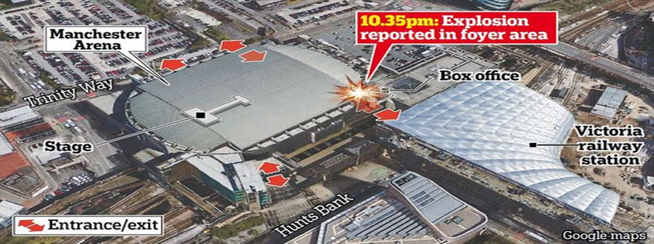
Explosion Manchester Monday, May 22, 2017

Slide 2
Terror has returned to Europe. Twenty-two people were killed after a blast at the Manchester Arena in Manchester, England on Monday evening (local time) shortly after the concert of American singer Ariana Grande - suicide bomber triggered the explosives near the exit of the concert - The bomb had nails, screws and bolts to cause as many victims as possible - Fears that the number of deaths will increase - The perpetrator was identified - The Islamic State assumed responsibility for the bomb attack.
The British police said the episode, killing at least 22 people and injuring at least 59 others, is seen as a terrorist incident. Indeed, the British Police allegedly identified the suicide bomber who had died in the Manchester Arena. According to the Wall Street Journal, "pieces" of the actor's body were found at the point of carnage.

Slide 3
The Islamic State Islamic Organization (ISIS) has assumed responsibility for the attack. The announcement, published by ISIS on one of its communication channels in social media, states that one of the "caliphate soldiers has put a bomb in the crowd" during the concert. The jihadist organization also threatens to launch other attacks.
Meanwhile, the BBC has reported that the offender is either a British or a British resident, but this has not been formally confirmed by the authorities.
Manchester police said they responded to reports of an explosion at the entrance of the stadium, which has a capacity of 21,000 people shortly after 22:35 local time (00:35 Greece time). The audience at the concert also included many children.

Slide 4
At the same time, the police chief of Manchester announced that "we are in a position to confirm that the assassin was killed after having triggered an explosive device." Always according to the police, the bomb was improvised.
A witness who attended the concert said he felt a huge explosion while leaving the stadium, followed by screaming and trembling by thousands of people trying to escape the building.
"We went to the exit and when we were right at the door there was a huge explosion and everyone started shouting," said Catherine Mc Farley, at Reuters. "The explosion was huge, you felt it on your chest. There was chaos. Everybody was running and screaming and trying to escape, "he added.

Slide 5
The Manchester Arena, one of Europe's largest closed stadiums, is a popular venue for concerts and sporting events.
Britain is on the second most urgent alarm scale, with a high chance of fighter attacks, while Britain's anti-terror service has said it captures almost one person a day with suspicion of terrorism.
"The terrorist incident will be the bloodiest attack in Britain since July 2015, when four British Muslims killed 52 people in London suicide bombers.

Slide 6
https://www.newsbomb.gr/kosmos/story/794550/manchester-live-etsi-xtypise-o-tromokratis-sti-synaylia-tis-ariana-grande
https://www.newsbomb.gr/kosmos/story/794599/ektakto-ekrixi-mantsester-to-islamiko-kratos-anelave-tin-eythyni-gia-tin-tromokratiki-epithesi

