Slide 1
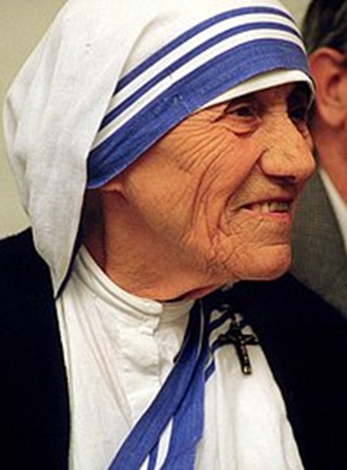
MOTHER TERESA

Slide 2
Mother Teresa was born on 26th August 1910 in Albania. He went to Darjiling in India in 1929 and swore a nun in 1931. In 1937 he worked as a teacher at a school in Kolkata. In 1950, she took permission from the Vatican to begin her missionary work. In 1952 he turned an old Hindu temple into Calcutta into a building to cure people who die. Also in 1955 he opened an orphanage in Kolkata. It then opened hospitals and orphanages all over India, but also in Rome, Tanzania and Austria.
In 1979 he won the Nobel Peace Prize. He traveled around the world to help the poor and the sick. For example, he helped hungry people in Ethiopia, the victims of the Chernobyl nuclear explosion in 1986, and the victims of the earthquake in Armenia in 1988. Mother Teresa died in 1997 in Calcutta, India.

Slide 3
"
Mother Teresa began her charity work on Calcutta's shacks and camps. He rented a hut and began to teach. Her reputation began to spread, ensuring the first financial donations. In October 1950, Mother Teresa founded her own battalion of nuns, the "Charity Prophets" .
In the course of time, the battalion, under the guidance of Mother Teresa, has set up a number of help centers for the blind, the elderly, the lepers, the disabled, the AIDS sufferers and the dying people. Her action has crossed the borders of India, herself touring around the world by proclaiming her humane message. On December 8, 1979, he was honored with the Nobel Peace Prize "for her contribution to the fight against poverty and misery, which is a threat to peace," while being honored with other awards and awards.

Slide 4
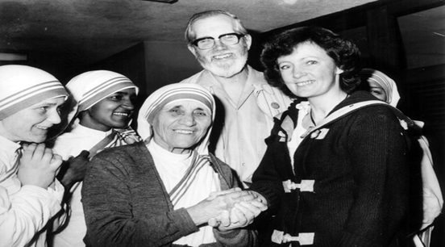
At a Vatican ceremony held by Pope Francis with more than 100,000 faithful, Mother Teresa was proclaimed "Saint" and recorded in the choirs of the saints of the Roman Catholic Church. Every year on September 5, the Catholic Church celebrates the "holy Teresa of Calcutta" after the decision of the competent committee of the Catholic Church …

Slide 5
My origin: I am Albanian.
My citizenship: I am Hindi.
My belief: I am a Catholic nun.
My call: I belong to the world.
My heart: it belongs totally
in the Heart of Jesus. "
"Life is a mystery; embrace it.
Life is sadness • overcome it.
Life is a hymn • sang it.
Life is an adventure • dare it.
Life is a struggle • accept it.
Life is life • protect it. "
Mother Tereza

Slide 6
https://el.wikipedia.org/wiki/%CE%9C%CE%B7%CF%84%CE%AD%CF%81%CE%B1_%CE%A4%CE%B5%CF%81%CE%AD%CE%B6%CE%B1, 31-08-18.
http://www.mixanitouxronou.gr/mitera-tereza-i-agia-ton-ftochon-i-katigories-gia-schesis-me-diktatores-gia-katachrisi-chrimaton-ke-oti-afine-tous-ftochous-na-ipoferoun-i-agiopi, 31-08-18.
http://ierapostoliagapis.org/%CE%B7-%CE%BC%CE%B7%CF%84%CE%AD%CF%81%CE%B1-%CF%84%CE%B5%CF%81%CE%AD%CE%B6%CE%B1-%CF%84%CE%B7%CF%82-%CE%BA%CE%B1%CE%BB%CE%BA%CE%BF%CF%8D%CF%84%CE%B1%CF%82, 31-08-18.

