Slide 1
September 11th attack
Bill Dallas

Slide 2
The September 11 attacks (also referred to as 9/11)were a series of four coordinated terrorist attacks by the Islamic terrorist group al-Qaeda against the United States on the morning of Tuesday, September 11, 2001. The attacks killed 2,996 people, injured over 6,000 others, and caused at least $10 billion in infrastructure and property damage. Additional people died of 9/11-related cancer and respiratory diseases in the months and years following the attacks.

Slide 3
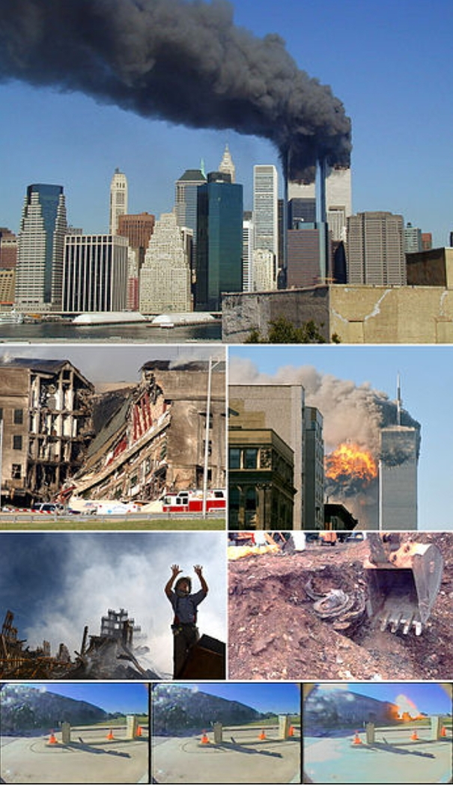
Top row: The Twin Towers of the World Trade Center burning
2nd row, left to right: Collapsed section of the Pentagon; Flight 175 crashes into 2 WTC
3rd row, left to right: A firefighter requests assistance at World Trade Center site; Ground Zero; An engine from Flight 93 is recovered
Bottom row: Flight 77's collision with the Pentagon as captured by three consecutive CCTV frames

Slide 4
Four passenger airliners operated by two major U.S. passenger air carriers (United Airlines and American Airlines)—all of which departed from airports in the northeastern United States bound for California—were hijacked by 19 al-Qaeda terrorists. Two of the planes, American Airlines Flight 11 and United Airlines Flight 175, were crashed into the North and South towers, respectively, of the World Trade Centercomplex in Lower Manhattan. Within an hour and 42 minutes, both 110-story towers collapsed. Debris and the resulting fires caused a partial or complete collapse of all other buildings in the World Trade Center complex, including the 47-story 7 World Trade Center tower, as well as significant damage to ten other large surrounding structures. A third plane, American Airlines Flight 77, was crashed into the Pentagon (the headquarters of the U.S. Department of Defense) in Arlington County, Virginia, which led to a partial collapse of the building's west side. The fourth plane, United Airlines Flight 93, was initially flown toward Washington, D.C., but crashed into a field in Stonycreek Township near Shanksville, Pennsylvania, after its passengers thwarted the hijackers. 9/11 is the single deadliest terrorist attack in human history and the single deadliest incident for firefighters and law enforcement officers in the history of the United States, with 343 and 72 killed, respectively.

Slide 5
Suspicion quickly fell on al-Qaeda. The United States responded by launching the War on Terror and invaded Afghanistan to depose the Taliban, which had failed to comply with U.S. demands to extradite Osama bin Laden and expel al-Qaeda from Afghanistan. Many countries strengthened their anti-terrorism legislation and expanded the powers of law enforcement and intelligence agencies to prevent terrorist attacks. Although al-Qaeda's leader, Osama bin Laden, initially denied any involvement, in 2004 he claimed responsibility for the attacks. Al-Qaeda and bin Laden cited U.S. support of Israel, the presence of U.S. troops in Saudi Arabia, and sanctions against Iraq as motives. After evading capture for almost a decade, Osama bin Laden was located and killed in Pakistan by SEAL Team Six of the U.S. Navy in May 2011.

Slide 6
The destruction of the World Trade Center and nearby infrastructure seriously harmed the economy of Lower Manhattan and had a significant effect on global markets, which resulted in the closing of Wall Street until September 17 and the civilian airspace in the U.S. and Canada until September 13. Many closings, evacuations, and cancellations followed, out of respect or fear of further attacks. Cleanup of the World Trade Center site was completed in May 2002, and the Pentagon was repaired within a year. On November 18, 2006, construction of One World Trade Center began at the World Trade Center site. The building was officially opened on November 3, 2014. Numerous memorials have been constructed, including the National September 11 Memorial & Museum in New York City, the Pentagon Memorial in Arlington County, Virginia, and the Flight 93 National Memorial in a field in Stonycreek Township near Shanksville, Pennsylvania.

Slide 7
Resources from Wikipedia
National Commission on Terrorist Attacks Upon the United States official commission website
National September 11th Memorial and Museum– List of victims
September 11, 2001, Documentary Project from the U.S. Library of Congress, Memory.loc.gov
September 11, 2001, Web Archive from the U.S. Library of Congress, Minerva
The September 11th Sourcebooks from The National Security Archive
September 11 Digital Archive: Saving the Histories of September 11, 2001, from the Center for History and New Media and the American Social History Project/Center for Media and Learning
DoD: Khalid Sheikh Mohammed Verbatim Transcript of Combatant Status Review Tribunal Hearing for ISN 10024, from Wikisource
Multimedia
Understanding 9/11 – A Television News Archiveat Internet Archive
CNN.com – Video archive, including the first and second planes
Remembering 9/11 – National Geographic Society
Time.com – 'Shattered: a remarkable collection of photographs', James Nachtwey
September 11, 2001, Screenshot Archive – Database of 230 screenshots from news sites around the world
Archive of newspaper front page images for 2001-09-11 at the Newseum

