Slide 1
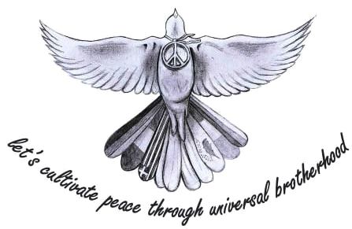
Terrorism in Europe
By Nina Petkova, Xa class

Slide 2
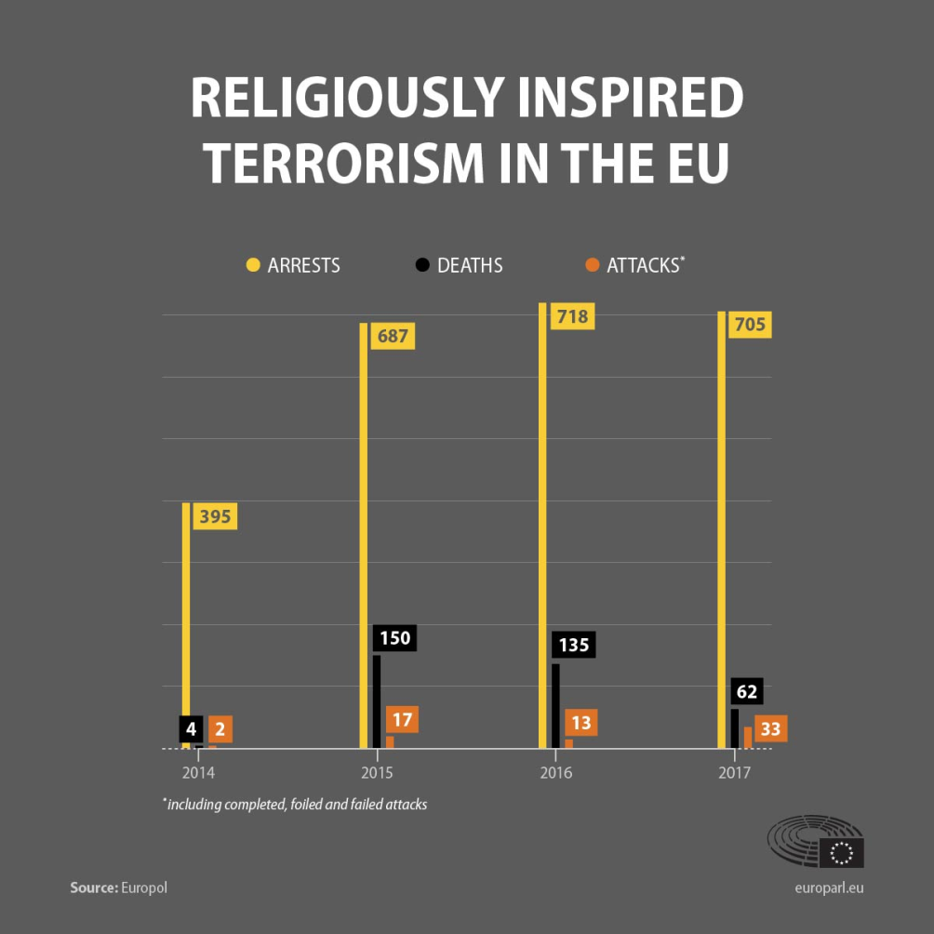
The terrorist threat has changed in nature in recent years. Check our graph to see the evolution of attacks, deaths and arrests since 2014.

Slide 3
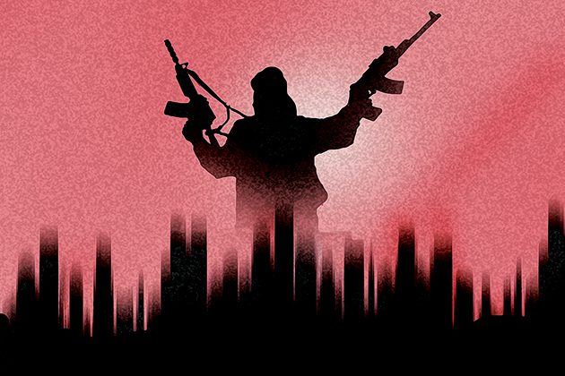
Situation in 2017
Ten of the 33 attacks were assessed as “completed” in 2017, while 12 failed to reach their objectives in full and 11 were foiled, mostly in France and the UK. That year 62 people died: UK (35), Spain (16), Sweden (5), France (3), Finland (2) and Germany (1). A further 819 people were injured. A total of 705 people were arrested in 18 EU countries (373 in France) on suspicion of involvement in jihadist terrorist activities.

Slide 4
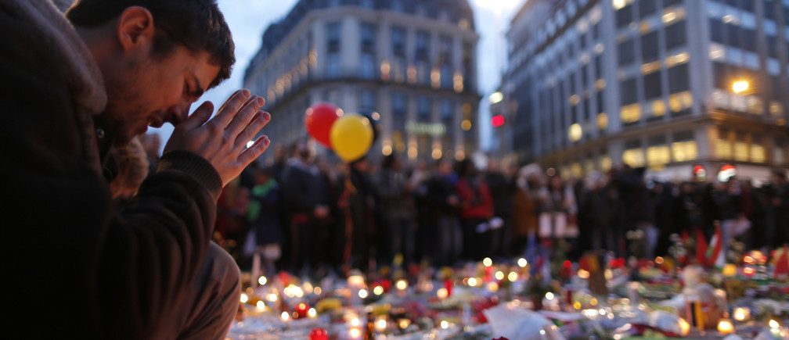
EU cooperation
The reinforced cooperation between EU countries, sharing information, has helped to prevent attacks, stop them or limit their impact, according to Navarrete. “The plots are identified earlier because the tools for intelligence and police are used in a more accurate way.” He added: “We are preventing [attacks] and mitigating the number of people that are killed or injured.".

Slide 5
Potential threats
However, despite the success of the common approach, it remains important to stay vigilant. Navarrete said: “One of the most significant threats is people that have been arrested for their connection with the foreign fighter phenomenon and will be released shortly."
Most attacks are now perpetrated by home-grown terrorist radicalised in the European country where they are living, without having necessarily travelled to conflict zones such as Syria or Iraq, he said.
“There are still people returning from conflict zones like Iraq, but the figures were very low in 2017.”

Slide 6
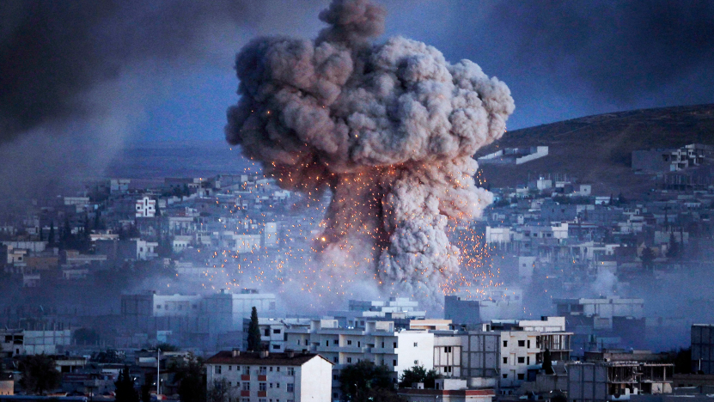
No systematic use of migration routes by terrorists
Some people have been concerned about the risk posed by migrants trying to enter Europe. Navarrette said: “We haven´t seen a systematic use of these routes by terrorists." However, he added that Europol had identified “some terrorists” who try to use migration routes to enter the EU and that is why it has reinforced its cooperation with countries such as Greece and Italy and remains “vigilant”.

Slide 7
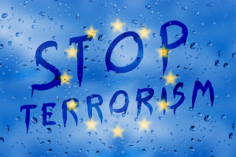
Thank you for watching!

