Slide 1
TERRORISM IN EUROPE

Slide 2
DEFINITION OF TERRORISM
There is no commonly accepted definition of "terrorism". Being a charged term, with the connotation of something "morally wrong", it is often used, both by governments and non-state groups, to abuse or denounce opposing groups.

Slide 3
TERRORISM IN EUROPE
There is a long history of terrorism in Europe. This has often been linked to nationalist and separatist movements, while other acts have been related to political extremism (including anarchism, far-right and far-left extremism), or religious extremism.

Slide 4
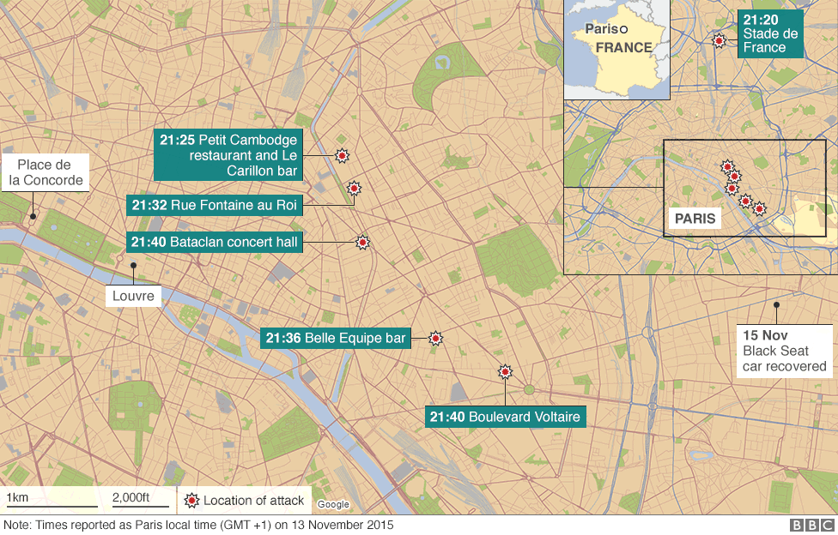
PARIS TERROR ATTACK
The attacks in Paris on the night of Friday 13 November by gunmen and suicide bombers hit a concert hall, a major stadium, restaurants and bars, almost simultaneously - and left 130 people dead and hundreds wounded.

Slide 5
November 13: Attack on Paris (Video)

Slide 6
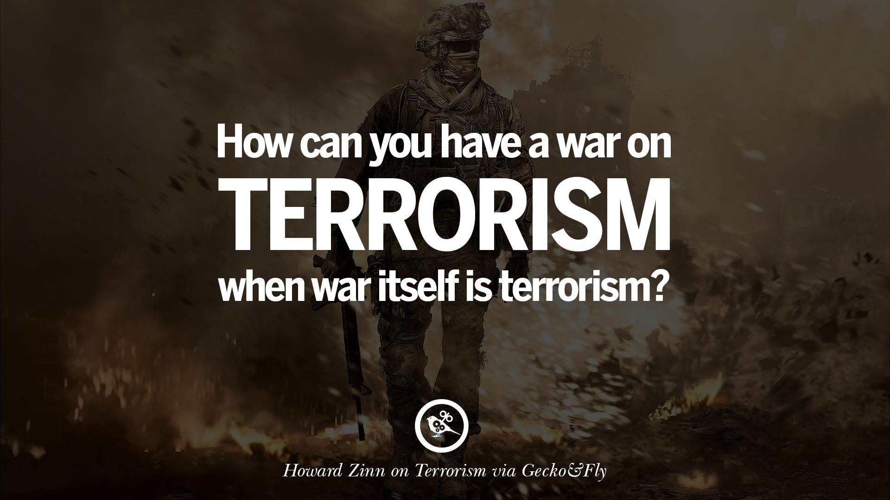

Slide 8
Made by: Gabriela Ivanova, ‘Peyo Yavorov’ High School

