Slide 1
TERRORIST ATTACK IN TURKEY 2016
Sources : https://en.wikipedia.org/wiki/March_2016_Ankara_bombing

Slide 2
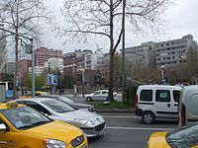
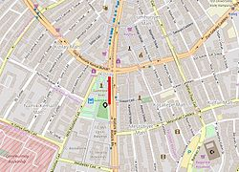
The area the terrorist attack took place
The terrorist attack on 13th March 2016 18:35 took place in Kizilay , Ankara.

Slide 3
The victims
The victims were 162
There were 125 injured and 19 heavily injure . And 37 were killed . Most of them were younger than 20 years old only few died with their families.

Slide 4
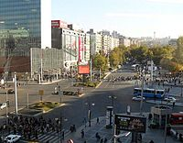
How the terrorist attack happened
A car with a bomb targeted the heart of Ankara which a lot of buses meet . When the buses met the car with the bomb exploded whilst going by a bus caring 40 civilians but fortunately only 20 were injured or even killed.
This is were the
car exploded

Slide 5
Who is believed that did the terrorist attack
It is believed that the TAK ( Kurdistan Freedom Hawks ) launched the terrorist attack in Ankara.

Slide 6
Who the Kurdistan Freedom Hawks are
The Kurdistan Freedom Hawks are a militant group in Turkey seeking an independent Kurdish state in eastern and southern Turkey. The group also opposes the Turkish government’s policies towards its ethnic Kurdish citizens.
The TAK’s
flag

