Slide 1
Saint Nedelya church assalut
Erasmus +
Silistra, Bulgaria

Slide 2
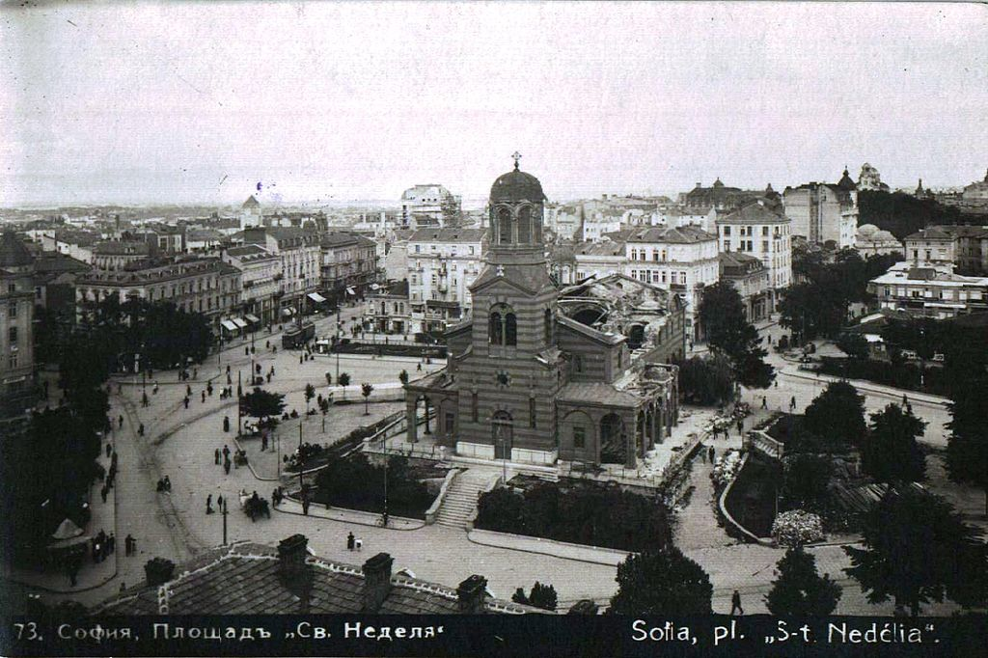
St Nedelya Church after the assault
The St Nedelya Church assault was a terrorist attack on St Nedelya Church in Sofia, Bulgaria. It was carried out on 16 April 1925, when a group of the Bulgarian Communist Party blew up the church's roof during the funeral service of General Konstantin Georgiev, who had been killed in a previous communist assault on 14 April.

Slide 3
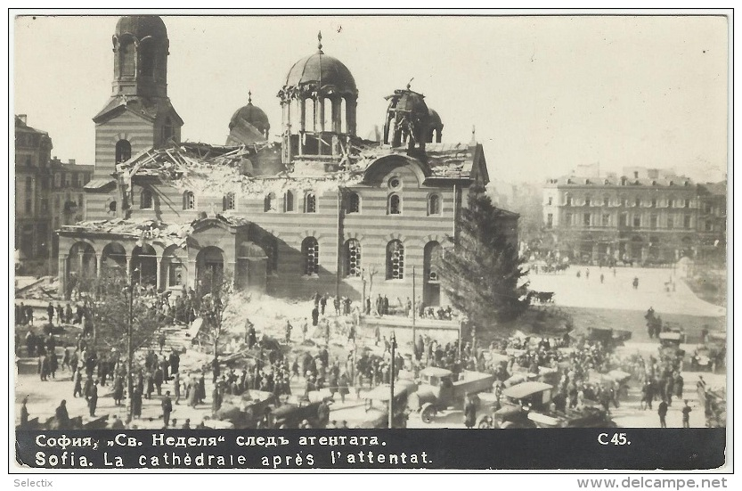
150 people, mainly from the country's political and military elite, were killed in the attack and around 500 were injured.

Slide 4
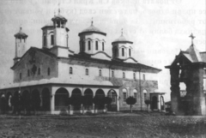
Many of the victims were friends or family of the general, elites, and much of the population did not appreciate the communists blowing up a church. The end result was a clampdown on not only the official Communist Party, but on any kind of activity deemed “anti-Bulgarian” by the government.

Slide 5
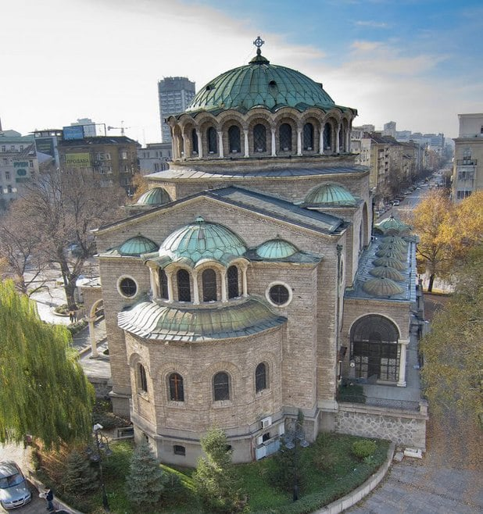
The communists of Bulgaria eventually got the last word when the Soviet Union invaded their country and established a dictatorship.
St. Nedelya church nowadays

Slide 6
Thank you for your attention!
Antonia Nikolova, XA “Peyo Yavorov” Language school

